Slide 1


Group 10
Analysis and Design of Algorithms
Ekta Goel A2305219658
Mitashi Bansal A2305219684
Devangna Jain A2305219647
Mansi Jain A2305219832
Rakshita Singh A2305219691

Slide 2

Contents
What this presentation covers?
01
Standard Method of Matrix Multiplication
04
Time Complexities using Master Method
02
Strassen's Matrix Multiplication Method
05
Worst case, average case and best case time complexities for quick sort
03
Recurrence Relations

Slide 3

Matrix Multiplication is a binary operation that produces a matrix from two matrices. For matrix multiplication, the number of columns in the first matrix must be equal to the number of rows in the second matrix. The resulting matrix, known as the matrix product, has the number of rows of the first matrix and the number of columns of the second matrix. The product of matrices A and B is denoted as AB.
Standard Method of Matrix Multiplication
Applications:
Scientific Computing
Pattern Recognition
Population Modeling

Slide 4
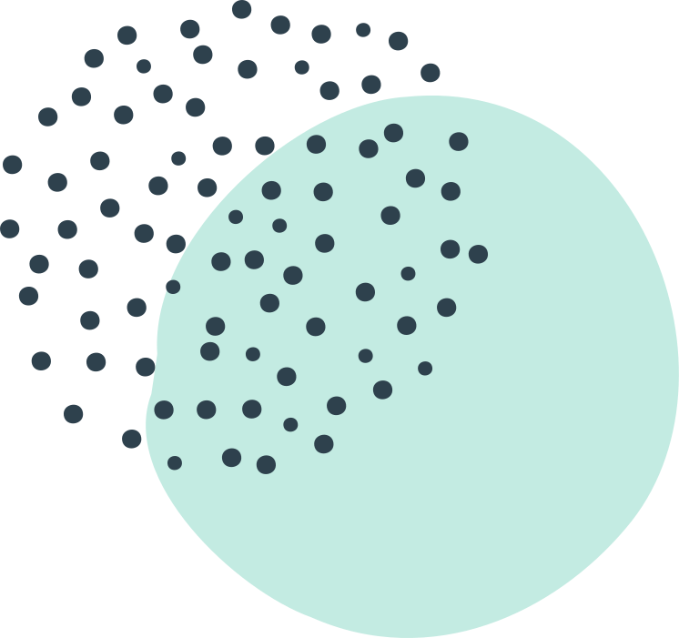
ALGORITHM:
Using conventional method we will see how to multiply two matrices. Suppose two matrices are A and B, dimensions of A is (m x n) and B is (p x q) and the resultant matrix can be found if and only if n = p. Then the order of the resultant matrix C will be (m x q).
matrixMultiply(A, B):
Assume dimension of A is (m x n), dimension of B is (p x q)
Begin
if n is not same as p, then exit
otherwise define C matrix as (m x q)
for i in range 0 to m - 1, do
for j in range 0 to q – 1, do
for k in range 0 to p, do
C[i, j] = C[i, j] + (A[i, k] * A[k, j])
done
done
done
End
Time Complexity:- O(n*3)

Slide 5

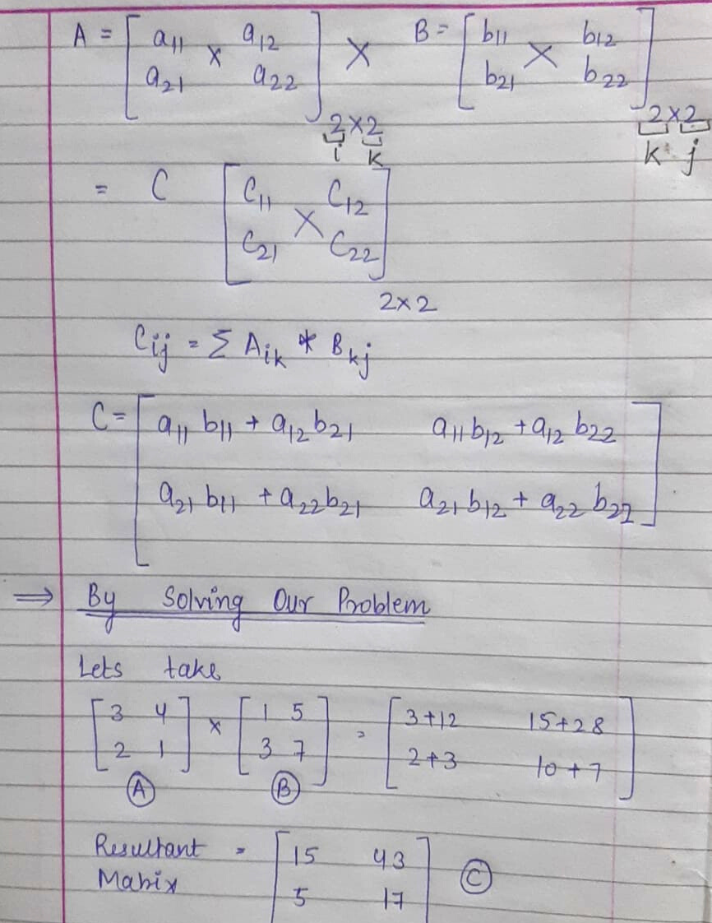
EXAMPLE

Slide 6

What is Strassen Multiplication
Strassen algorithm is a recursive method for matrix multiplication where we divide the matrix into 4 sub-matrices of dimensions n/2 x n/2 in each recursive step.
Strassen Matrix Multiplication
Ease of use
Strassen’s Algorithm is an algorithm for matrix multiplication. It is faster than the naive matrix multiplication algorithm.
Strategy
Strassen algorithm is based on divide and conquer strategy or approach. It was published by Volker Strassen.

Slide 7
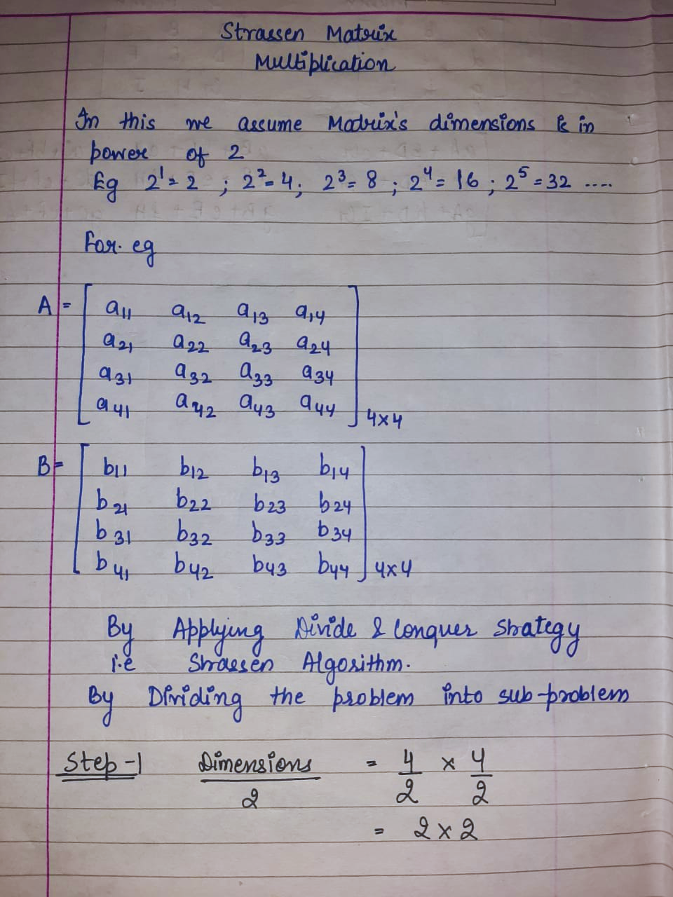
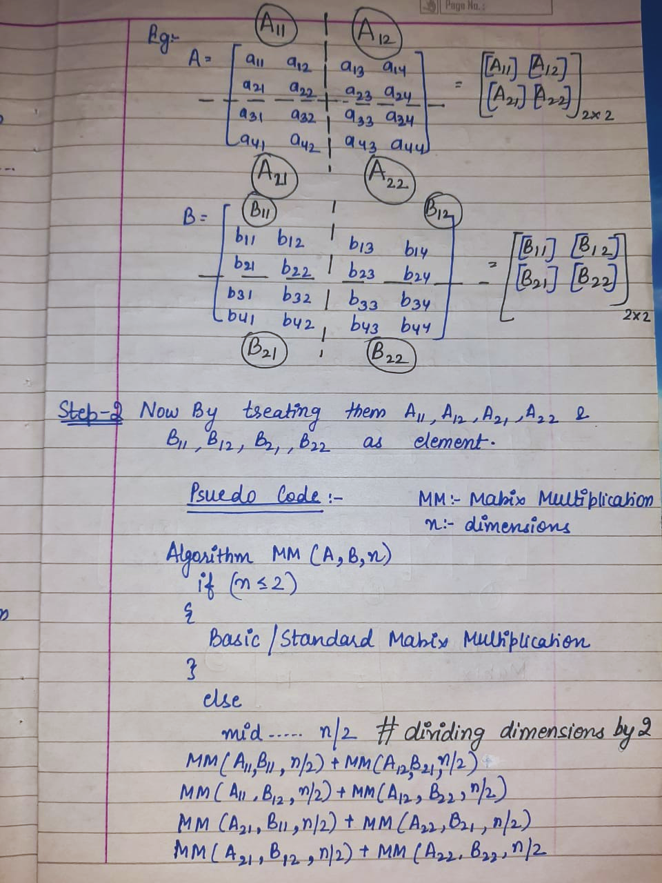
STRASSEN ALGORITHM
AN INTRODUCTION
STEP -1 Divide a matrix of order of 2*2 recursively till we get the matrix of 2*2.
Strassen Algorithm

Slide 8
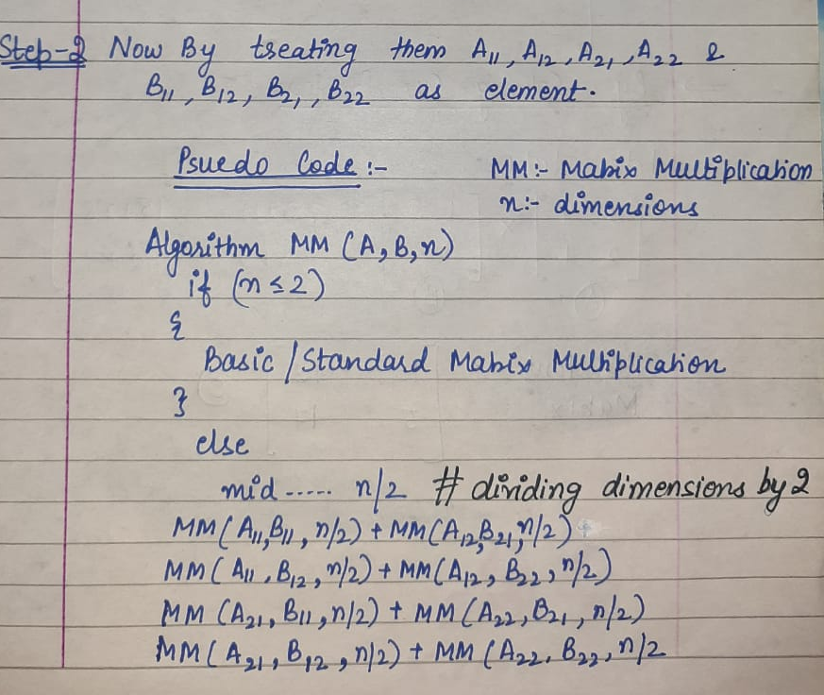
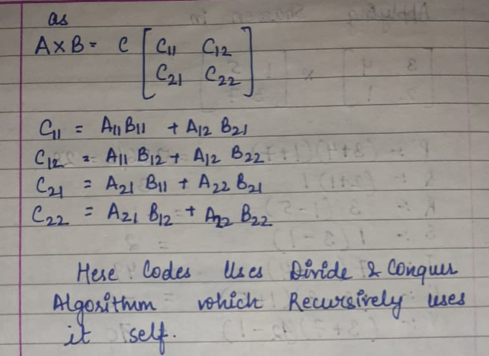
STRASSEN ALGORITHM
IN ADDITION
STEP -2 Use the previous set of formulas to carry out 2*2 matrix multiplication by treating them as element.
Strassen Algorithm

Slide 9
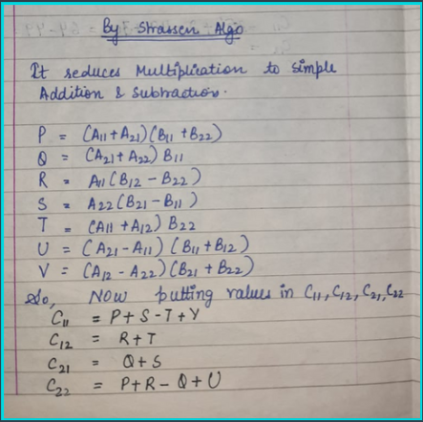
STRASSEN ALGORITHM
FURTHERMORE
STEP- 3 In this eight multiplication and four additions, are converted into seven equations resulting into simple values of resultant matrix.
STEP-4 Combine the result of two matrixes to find the final product or final matrix.
Strassen Algorithm

Slide 10
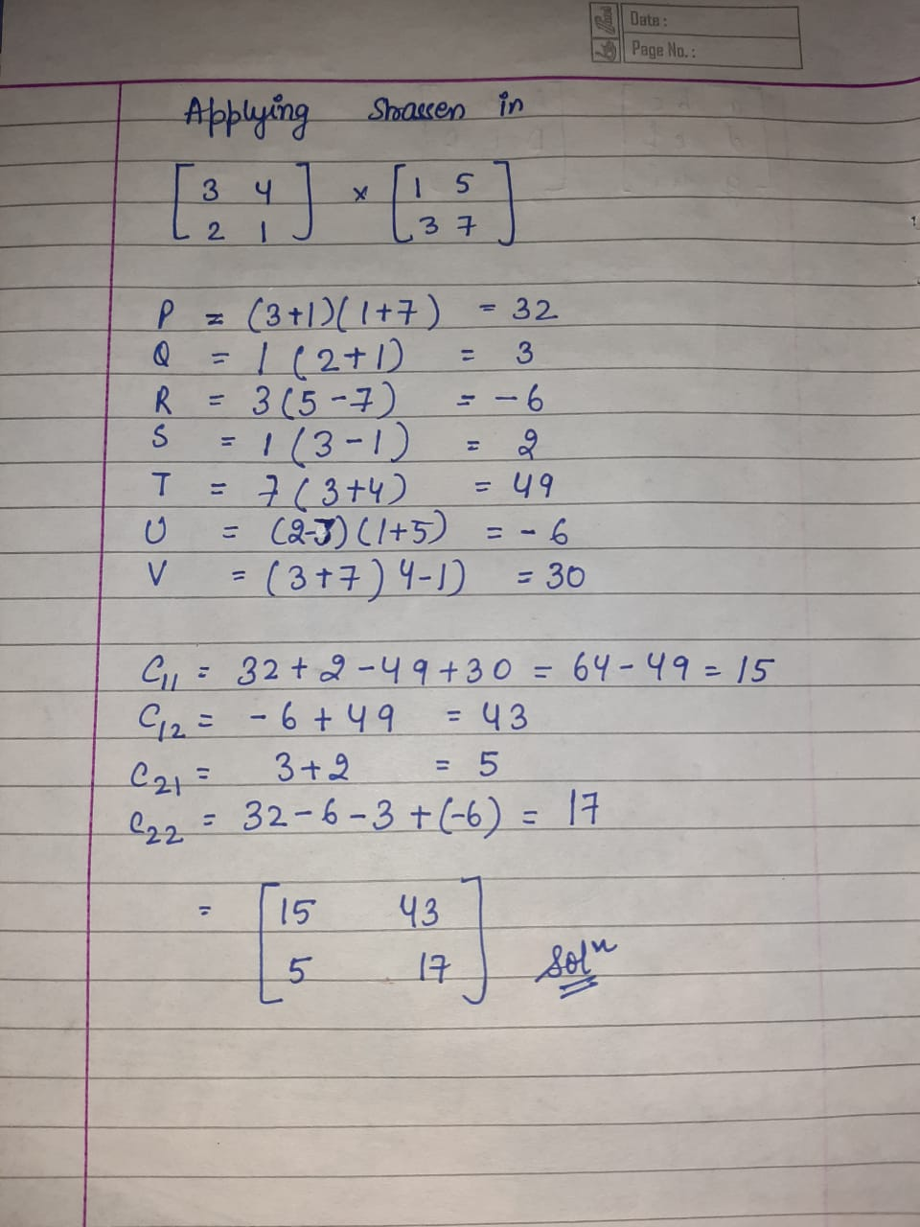
BY
Strassen
MATRIX MULTIPLICATION

Slide 11

Recurrence Relation
Divide & Conquer
Strassen Algorithm
T(N)=8T(N/2)+O(N^2)
T(N)=7T(N/2)+O(N^2)

Slide 12

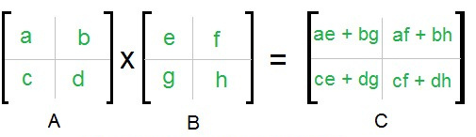
Divide And Conquer

Slide 13
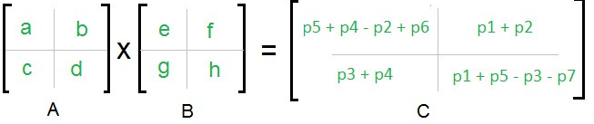
Strassen's Algorithm

Slide 14
Time Complexity using Master Method
Standard Algorithm
Divide & Conquer Method
Strassen Algorithm
Time Complexity: O(n^3)
Time Complexity: O(n^3)
Time Complexity: O(n^2.8074))

Slide 15
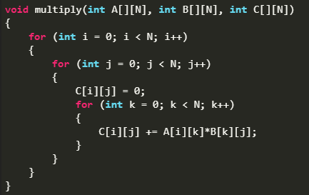

Standard Algorithm
Time Complexity: O(n^3)

Slide 16
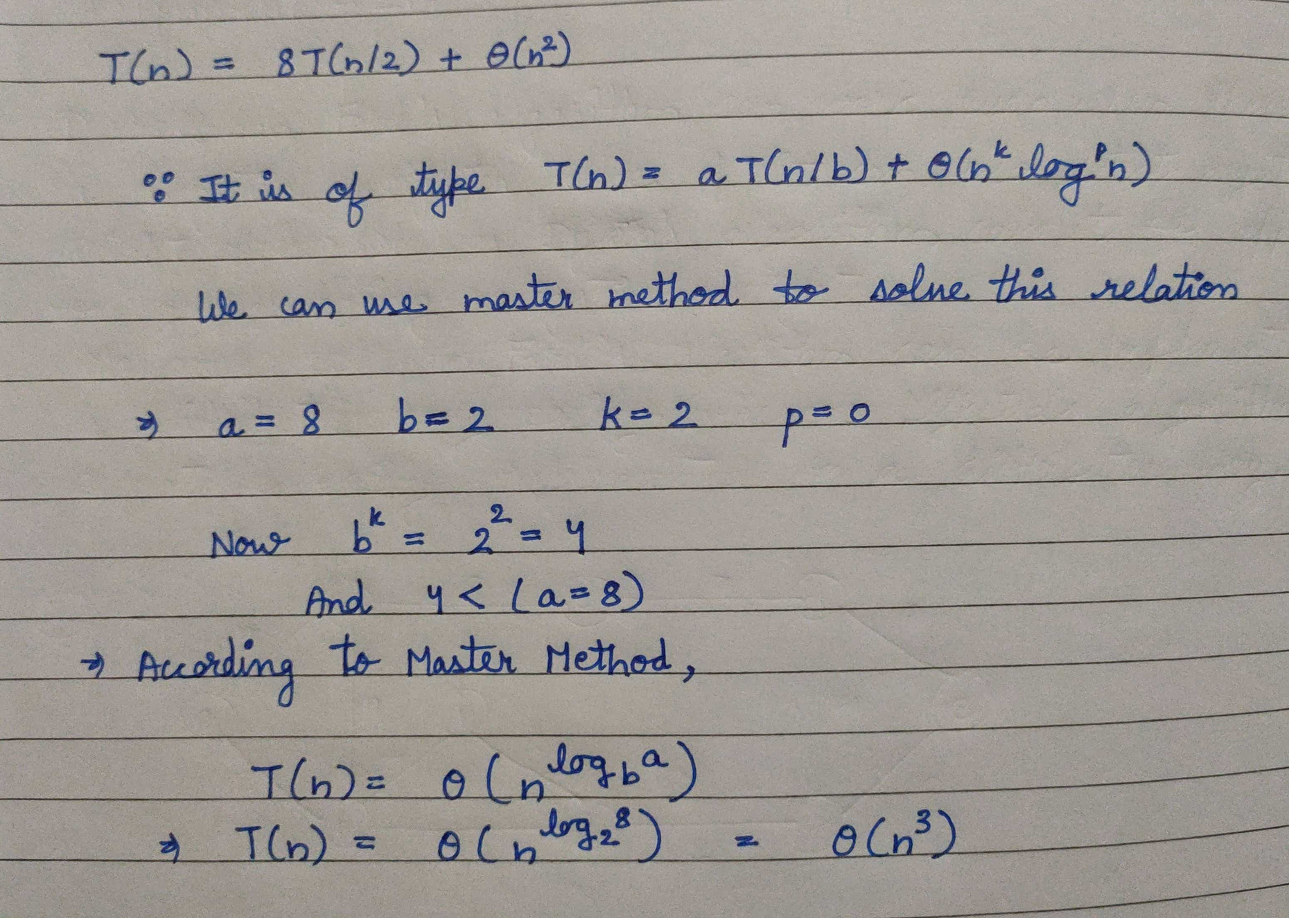
Divide & Conquer Method
Time Complexity: O(n^3)

Slide 17
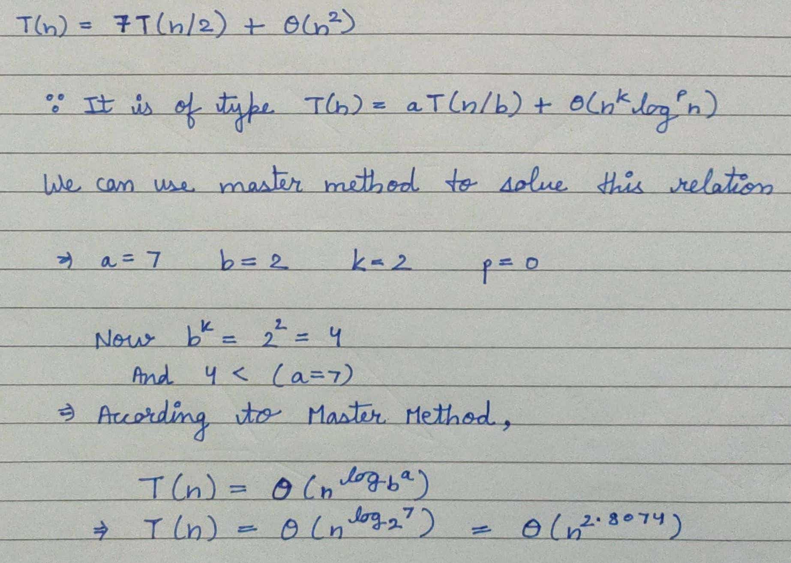
Strassen Matrix Multiplication
Time Complexity: O(n^2.8074))

Slide 18
Time Complexities of Quick Sort
Worst Case
Best Case
Time complexity:
O(n log n)
Time complexity: O(n²)
Average Case
Time complexity:
O(n log n)

Slide 19
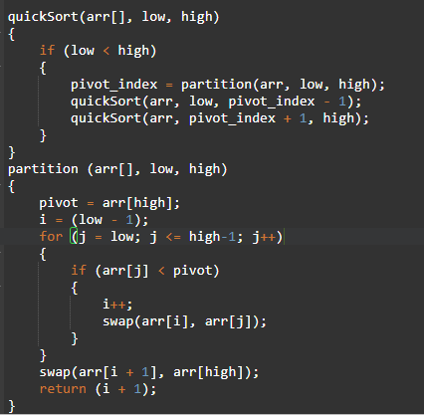

Quick Sort Algorithm Pseudocode

Slide 20
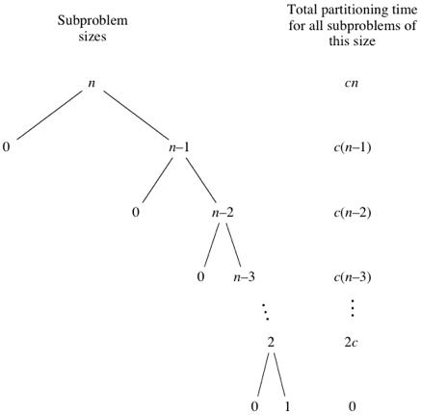
Worst Case:
O(N^2)
Pivot : Either greatest or smallest in array

Slide 21
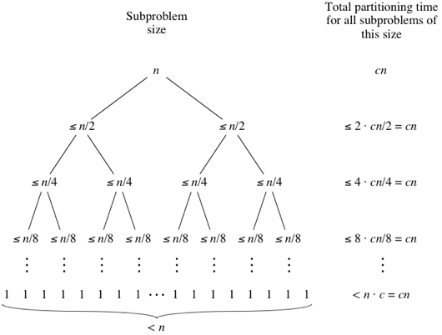
Best Case:
O(nlogn)
Pivot : Middle element of array

Slide 22
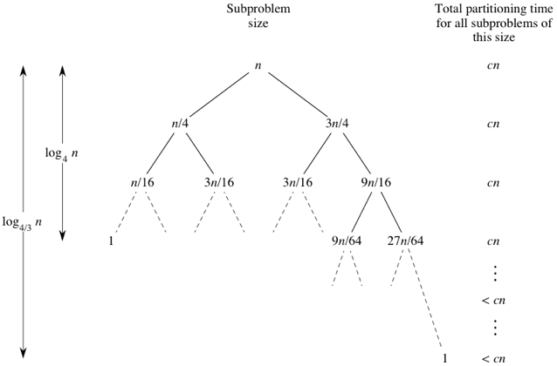
Average Case:
O(nlogn)
Pivot : Random element

Slide 23

Thank you!

